Slide 1
Leader in Cloud and Object Storage for Enterprise IT
Prepared by Paul Turner
Notes:
Presentation Title: Scality Enterprise Customer Sales Pitch
Last Edited: January 2017
Presentation Goal: Introduction to today’s digital enterprise storage challenges and the Scality solution value proposition
Target Audience: Anyone within an organizations needing a basic introduction to the issues, implications and solutions available for today’s current digital business realities as they relate to storage requirements and predictability, scalability reliability/durability, as well as enterprise ready cost-effective solutions. For Service Providers please use the related Service Provider presentation.
Speaking Points:
Welcome (introduce yourself and other associates)
Get to know your audience (ask about current levels of storage understanding, their current role in the decision/evaluation process, …)
Over the next 30-45 minutes we will discuss the current trends effecting every enterprise and service provider today; specifically the effect digital business requirements are putting on your storage infrastructure for performance, reliability, durability, enterprise readiness and predictability at petabyte scale
We’ll also introduce you to Scality’s software defined storage solution as a world leader in object and cloud storage
Discovery Opportunity:
How familiar are you with your current and near-term future storage strategy? Can you share highlights?
What specific issues would you like to discuss today? How much time do we have?

Slide 2




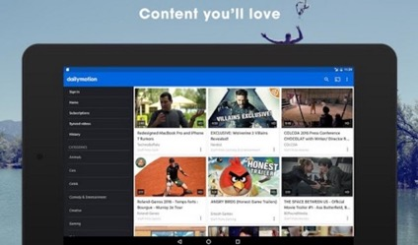


Digital Transformation impacts every industry
Notes:
Slide Goal: Highlight specific instances where digital business has transformed industries
Speaking Points:
Renault – the car industry is rapidly changing and Renault, one of the worlds leading car manufacturers, is using data to deliver the smart autonomous vehicles and a rich data experience for its customers
GE – the New York Times describes GE as a 124 year old startup and is leading efforts for IoT (internet of things) in industrial devices – by 2020, GE estimates that data flowing from its machines will jump 100 times from the 2016 number.
Dailymotion – Netflix and Youtube are examples of the digital change to our media viewing – dailymotion for example delivers on online movie and streaming tv to 300million users yvery month.
Bank of America – is implementing their own private cloud for secure data management and protection for all their critical data applications.
Discovery Opportunity:
Is your industry ready for this type of transformation?

Slide 3
You Need Digital Business Ready Storage
Notes:
Slide Goal: Transition slide to set stage for software defined storage as the ultimate solution to digital business storage requirements
Speaking Points:
In an age where how fast and efficiently you can serve your audience directly effects your ability to succeed, moving to digital business ideals is mandatory
Your storage infrastructure will be the foundation from which you build this success
Knowing which storage architectures are best for your digital business needs requires an understanding of what is now possible
Discovery Opportunity:
Are you ready to look into new storage techniques that eliminate your dependency on proprietary hardware and forklift upgrades?

Slide 4
Software Defined Object Storage is the Answer…
Petabyte Scalability
Scale capacity and performance on demand
Highly automated operations
Always-on
100% availability guaranteed
Cloud Optimized
API and Access Compatible with Cloud
Enterprise Ready
Secure and Enterprise IT integrated
Complete freedom of Hardware choice
Supports file and object natively
Notes:
Slide Goal: Introduce concept Software Defined Storage (SDS)
Speaking Points:
What you need is software-defined object storage that allows you to scale beyond petabytes that is easy to manage at scale, while ensuring system security, continuous Always-On uptime and reliability.
Software-defined storage (SDS) allows you to implement your own Private Cloud service which can act just like the public cloud services from Amazon and Google. The data storage software is independent of the underlying hardware and allows you to dynamically grow your storage needs with those of your business.
Flexible, Scalable, Secure and always on.
Discovery Opportunity:
Are you familiar with SDS?
Which specific products do you have familiarity with?

Slide 5
…and Reduces Cost
Scale-out globally, multiple workloads
Keep productivity up with next to zero downtime
Protect the data integrity with over 10 nines
EXECUTIVE SUMMARY
Return on Investment:
Net Present Value:
Cost Advantage:
229%
$8.0M
$3.1M
SOURCE: Forrester Report – The Total Economic Impact of Scality RING for 2 petabytes growing to 4 petabytes
Notes:
Slide Goal: Reminder that Scality is the most effective solution for petabyte scale (from analyst reports)
Speaking Points:
In 2016, Forrester did a Total Economic Impact study (TEI), to look at the benefits of the scality RING compared to traditional NAS storage arrays. This was a detailed analysis done by interviewing our customers and then building a comparative analysis to traditional storage.
The benefits were clear – $8m in expected cost savings over the life of the storage, over $3m from capital savings alone and a 229% ROI over the life of the storage.
It also delivered a capital payback within only 6months
The key benefits which Forrester found where
Avoided Capital expenditures on traditional scale-out NAS solutions.
Improved availability and durability with zero downtime
And increased business productivity since they could now deliver new storage on-demand as the business required.
Discovery Opportunity:
Would you be interested in a custom ROI/TCO analysis for your needs?

Slide 6
Key Use Cases
On-Premises Private Cloud
Backup ECM / Imaging / Compliance
Content Delivery Networks Video On Demand Video Nearline Archive
Large Video Surveillance Systems
MAM – simplified worldflow
CDN – manage costs and stream many
Low Cost active Archive – readily available over tape
Video Transcoding – agile content parking
VOD
Notes:
Slide Goal: Introduce specific use cases where Scality solutions excel
Speaking Points:
Scality has proven success in these use cases
Scality also has the partner ecosystems to ensure success with these use cases
Discovery Opportunity:
Which of these use cases are most interesting to you at this time?
Are there any others that may be of interest in the coming year?

Slide 7
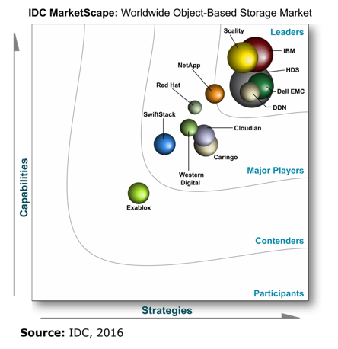
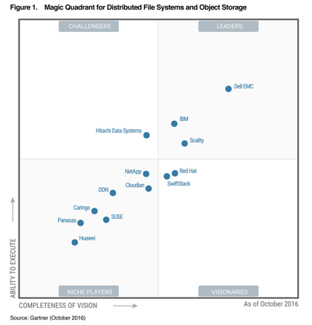


Proven by Analysts
Scality is Object & Scale-Out File Storage Leader

Slide 8


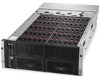
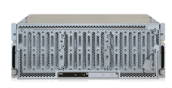
Only Scale-out Storage Supplier for All Three Server Leaders
Scality is Preferred Solution Partner of Cisco
Key solution of Cisco DCS (Data Center Services)
Reference architectures with Cisco UCS S3260, C240 M4, C220 M4
Resells Scality as their sole “Scale-out file and object” solution
Reference architectures with HPE Apollo 4510, 4200, 4530 / Cloudline
Joint engineering
Strategic venture investment
Resells Scality as a “SDS object storage” partner
S7000 File and Object Storage
Reference architectures with Dell R730xd, R630 + MD3060e, and DSS7000
Notes:
Slide Goal: Introduce Scality alliance partnerships
Speaking Points:
Scality is the only storage vendor with strong partnerships with over 50% of the server market.
HPE, Dell, and Cisco each offer a wide range of hardware that can be deployed with Scality: from performance-oriented to capacity-optimized.
You can buy Scality through HPE or Dell today.
Discovery:
Are you already a customer of one (or more) of these vendors?
Which is your preference for easy of acquisition and support?

